Slide 1
Project 9: EKF-based Localization with LRF
Presentation 1:
Task, Theory and Approach

Slide 2
Outline
Task
Extended Kalman Filter
Solution Approach
Questions

Slide 3
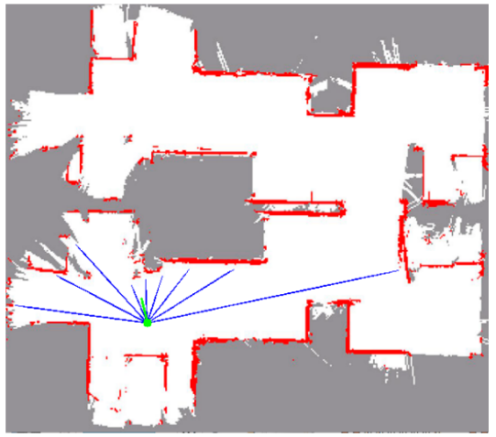
Task
Goal: estimate location & orientation in real time
Method:
Implement an EKF
Use odometry for prediction
Compare LRF measurements with map- based expected measurements for updates
Use SLAM package for obtaining the map
Implement robustness to kidnapping and global localization

Slide 4
Extended Kalman Filter (1)
Update
Prediction
Matching/
Filtering
Algorithm to achieve relative and absolute localization
Three staged recursive process
Depends on the previous knowledge of the environment
Sensitive to initial estimate or modelling errors
Notes:
Disadvantages of the extended Kalman filter:
Unlike its linear counterpart, the extended Kalman filter in general is not an optimal estimator (of course it is optimal if the measurement and the state transition model are both linear, as in that case the extended Kalman filter is identical to the regular one). In addition, if the initial estimate of the state is wrong, or if the process is modeled incorrectly, the filter may quickly diverge, owing to its linearization. Another problem with the extended Kalman filter is that the estimated covariance matrix tends to underestimate the true covariance matrix and therefore risks becoming inconsistent in the statistical sense without the addition of "stabilising noise".
Having stated this, the extended Kalman filter can give reasonable performance, and is arguably the de facto standard in navigation systems and GPS.

Slide 5
Extended Kalman Filter (2)
Update
Prediction
Matching/
Filtering
EKF updates knowledge of world map using
Obtained observations
New position

Slide 6
Extended Kalman Filter (3)
Update
Prediction
Matching/
Filtering
Odometry based estimate
Observation model estimate
Combining the two estimates
Notes:
The world Map is a group of Points and Line segments constituing landmarks.
The Observation Model creates a mapping of the observation using the information received from the sensor model. Each sensor model has characteristics such as spatial perception and effective beamwidth which give us the limits of our observations.

Slide 7
Extended Kalman Filter (4)
Update
Prediction
Matching/
Filtering
Match prediction with observations at new state
Avoids miscalculations
If matching is successful state and world map is updated
Notes:
After the prediction stage of the algorithm it is necessary to match the prediction with the observations at the new state in order to avoid miscalculations. We therefore do a matching of the observations we predicted and the real world observations. All this is necessary to avoid EKF divergence, ignore outlier observations and to ignore erroneous or inexistent predictions.
If a matching fails then we go to the "detection and correction of bias", here we calculate a new state vector and a new observation vector and then match the observation vector with the real world observation to see if it a correct prediction.

Slide 8
Solution Approach (1)
Mapping the room
Combining pre-acquired map with the mapped room
Building autonomy
Optimizing for the problem
EKF

Slide 9
Solution Approach (2)
Mapping: robot needs to describe the environment
Geometric
Describe environment in metric terms without considering landmarks
Problems:
Detect object through sensors
Understand provided information
Find a computationally inexpensive model
Odometry can be inaccurate due to wheel slippage
Noise e.g. from mirrors
Topological
Describe environment in terms of certain features in specific locations and ways from going from one location to another

Slide 10
Solution Approach (3)
Combining with pre-acquired map:
The robot needs to match the mapped portion of the room with the pre-acquired map
Problems:
Objects that were moved won’t match
There may be small errors, maps won’t overlap
Similar parts in the map might lead to a mismatch
The correspondence algorithm has to be quick
In this phase, the robot will be able to determine its location

Slide 11

Solution Approach (4)
Building Authonomy:
The Robot will make decisions, based on objectives

Slide 12
Questions
Which robot and sensor models will we use?
What are the objectives?
What should the robot be optimized for?
Will objects be moved during the experiment?

